Slide 1
Overhead Guidance System
Josh Field, Blake McHale, James Tyler & Theodore Lutkus

Slide 2
Outline
The Problem
Approach
Technical Scope
Timeline & Budget
Future Applications

Slide 3

The Problem
Background
In 2015 there were 36 million blind people worldwide
Guide dogs cost around $48,000
Visually impaired need help
Challenges
Find crosswalk safely
Intuitive to use

Slide 4
Human-Centric Design
Human
Blind or possesses visual limitations, likely has increased auditory and tactile perception, able to use a sighted guide
Activity
Needs to be able travel through busy areas safely (without impacting obstacles)
Assistive Technology
Use a “sighted” computer to detect obstacles and plan a safe, efficient path

Slide 5
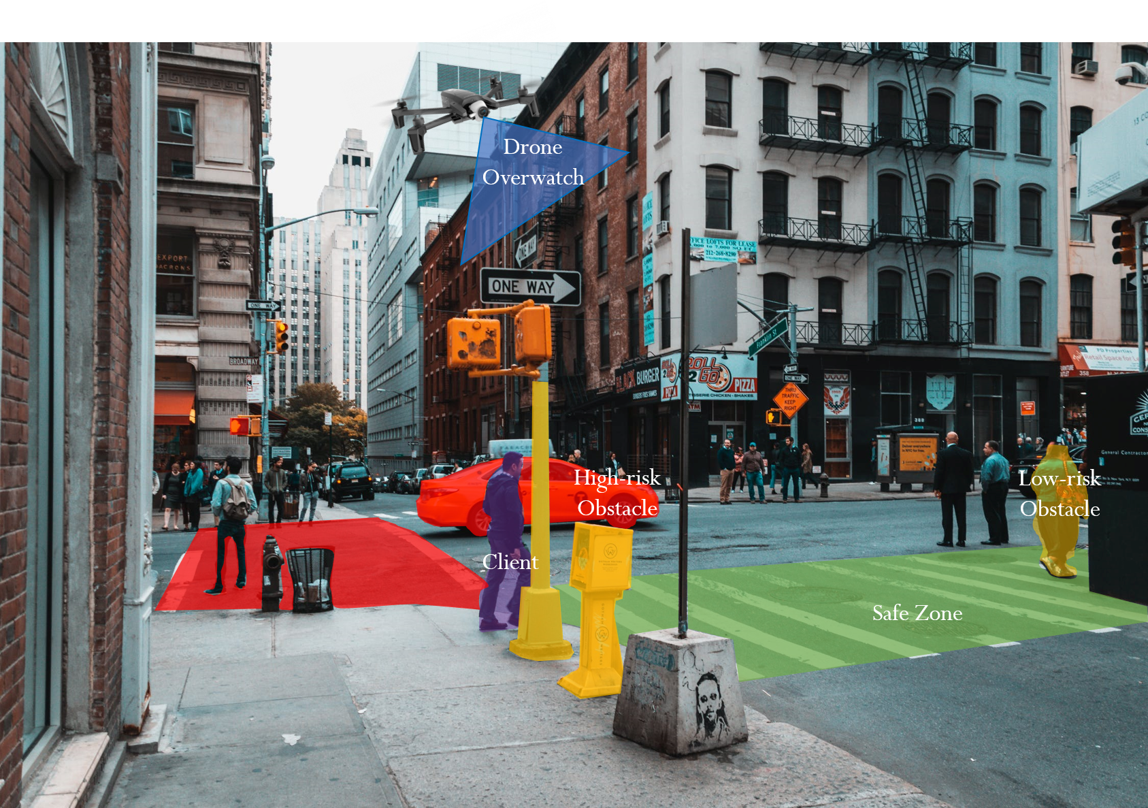

Slide 6
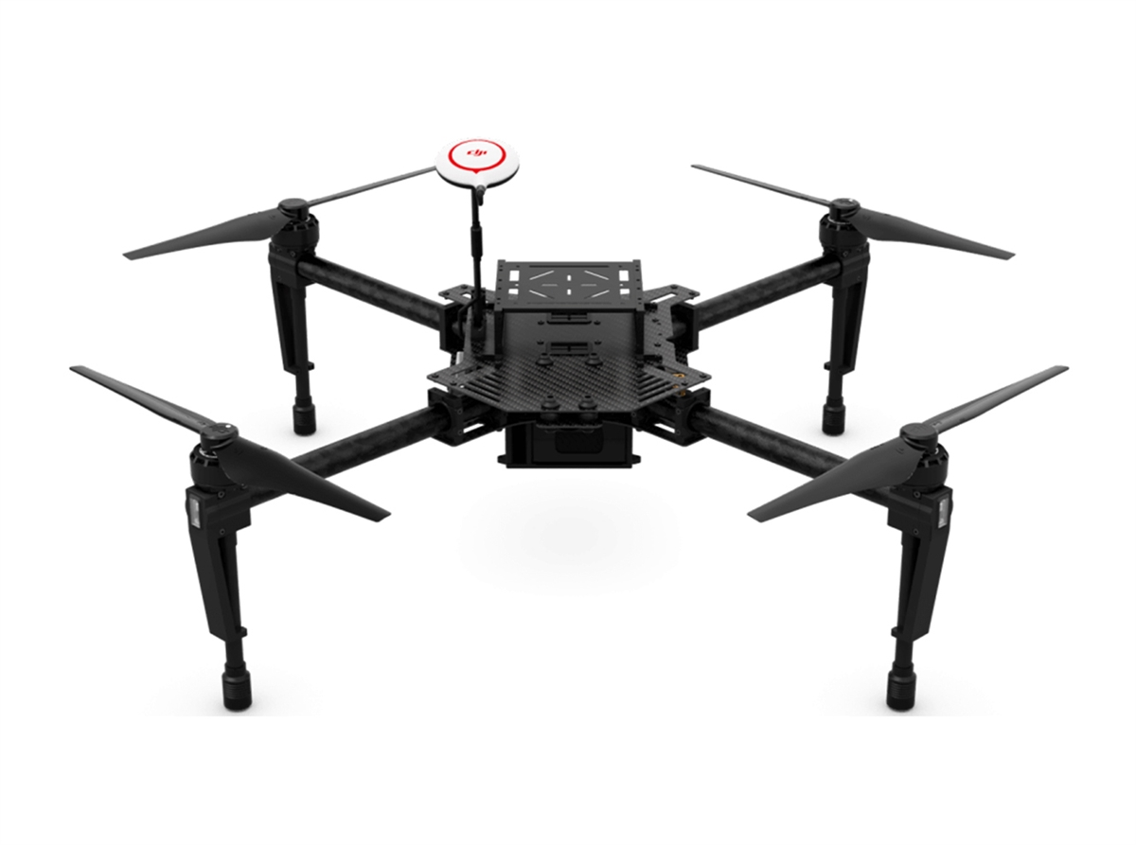
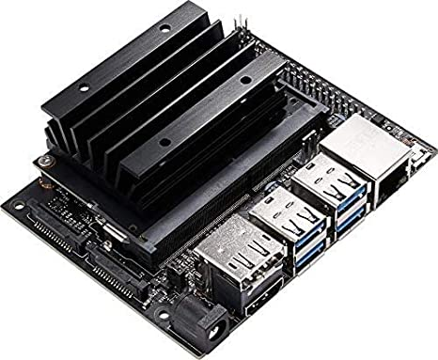
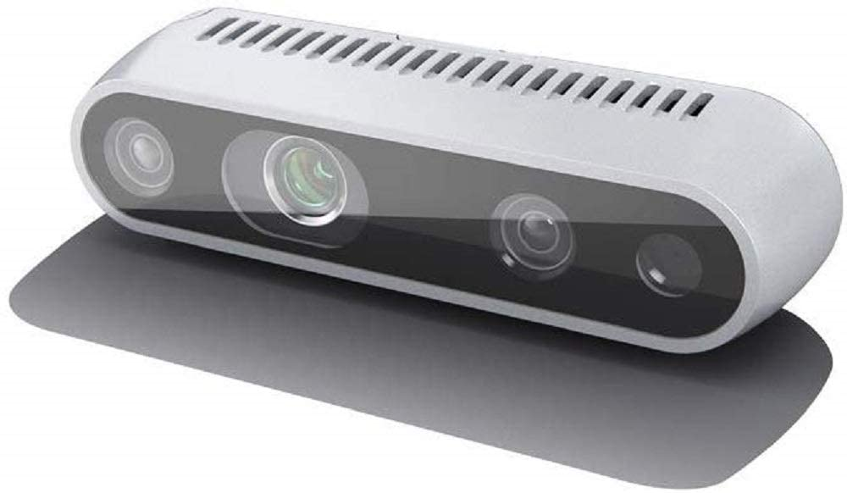
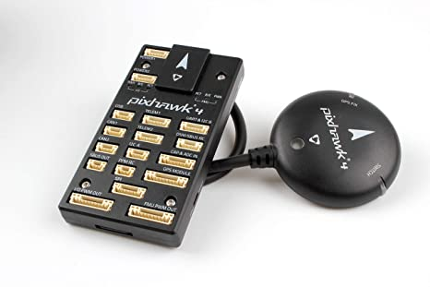
Technical Scope - Aerial Hardware
Full Scope:
On-board computing
Jetson (Nano, TX2, Xavier, etc.)
Depth camera (Intel Realsense)
Flight controller (Pixhawk 4)
IMU
GPS
Drone platform (DJI Matrice 100)
Our Scope:
Fixed camera + simulation

Slide 7
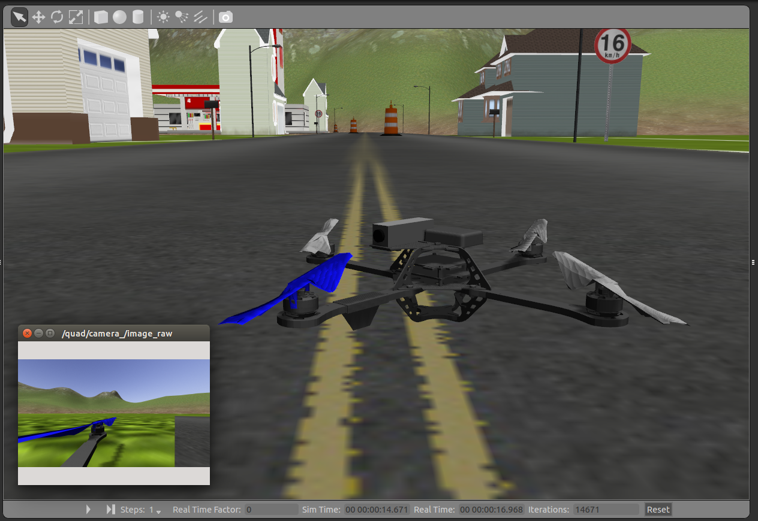
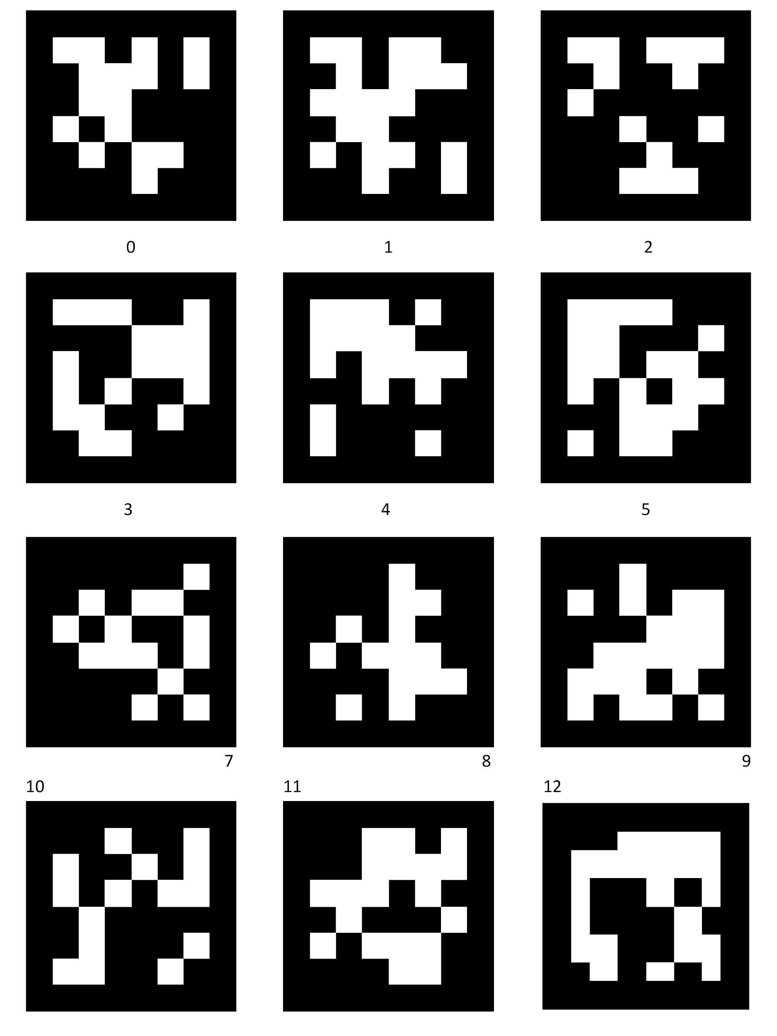
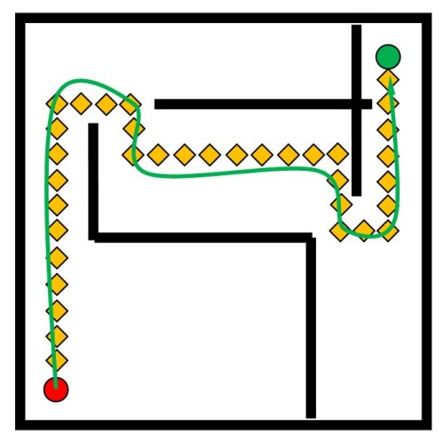
Technical Scope - Software
ROS as a communication framework
Simulation
Gazebo
Ardupilot
Computer vision
AprilTags as obstacles
Path planning
Issuing scalar-value tactile guidance for operator via wireless network:
“move left” or “move right”

Slide 8
Software Process
AprilTag Pose Estimation
Guidance Command Generation
Camera
Path Planning
Client Pose Estimation

Slide 9
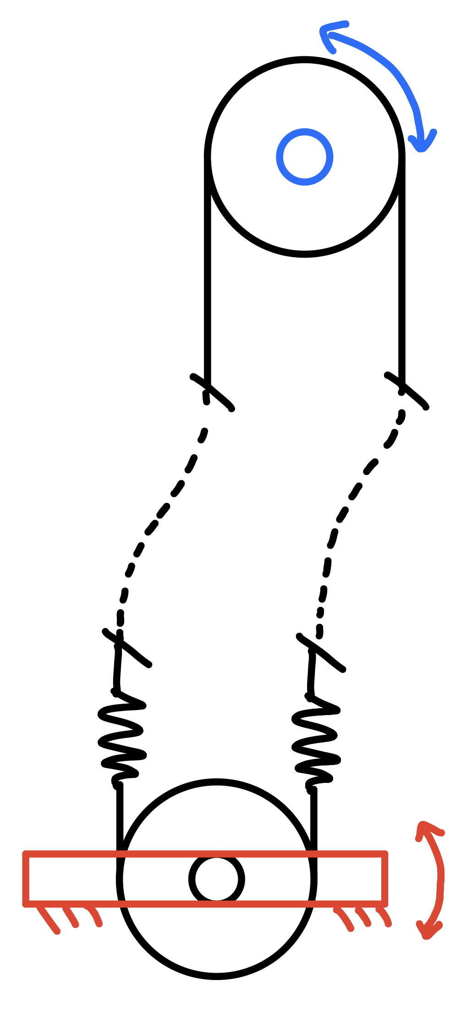
Technical Scope - Tactile Guidance
Series elastic actuators (SEA)
Safe, compliant force to guide
Bowden cables
Flexible power transmission so client does not need to hold motor
Keeps motor and other electronics dry when raining
Motor
(Away from hand)
Bowden Cables
Elastic Springs
Output Lever (At Hand)
Move left
Move right

Slide 10
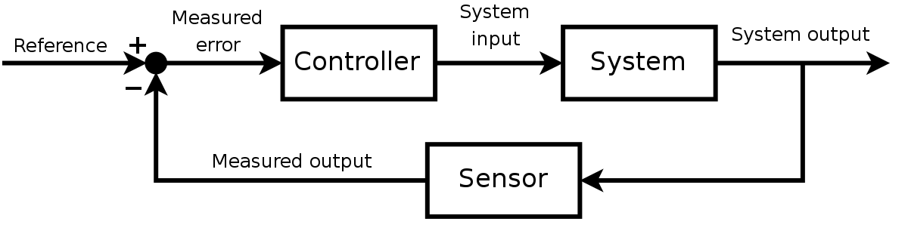
Technical Scope - Guidance Control
Torque PID feedback controller
Hooke’s Law applied to SEA spring displacements to measure torque
Reference maps “left-right” path planning to torque applied to client

Slide 11
Budgeted Items
SEA Guidance Components
High-precision servo motor (~$20-30)
Springs (~$10)
Bowden cables (~$20)
3D printed material costs (~$15)
STM32F411 Guidance Microcontroller (Owned already)
Potentiometer for SEA spring feedback sensing (~$5)

Slide 12
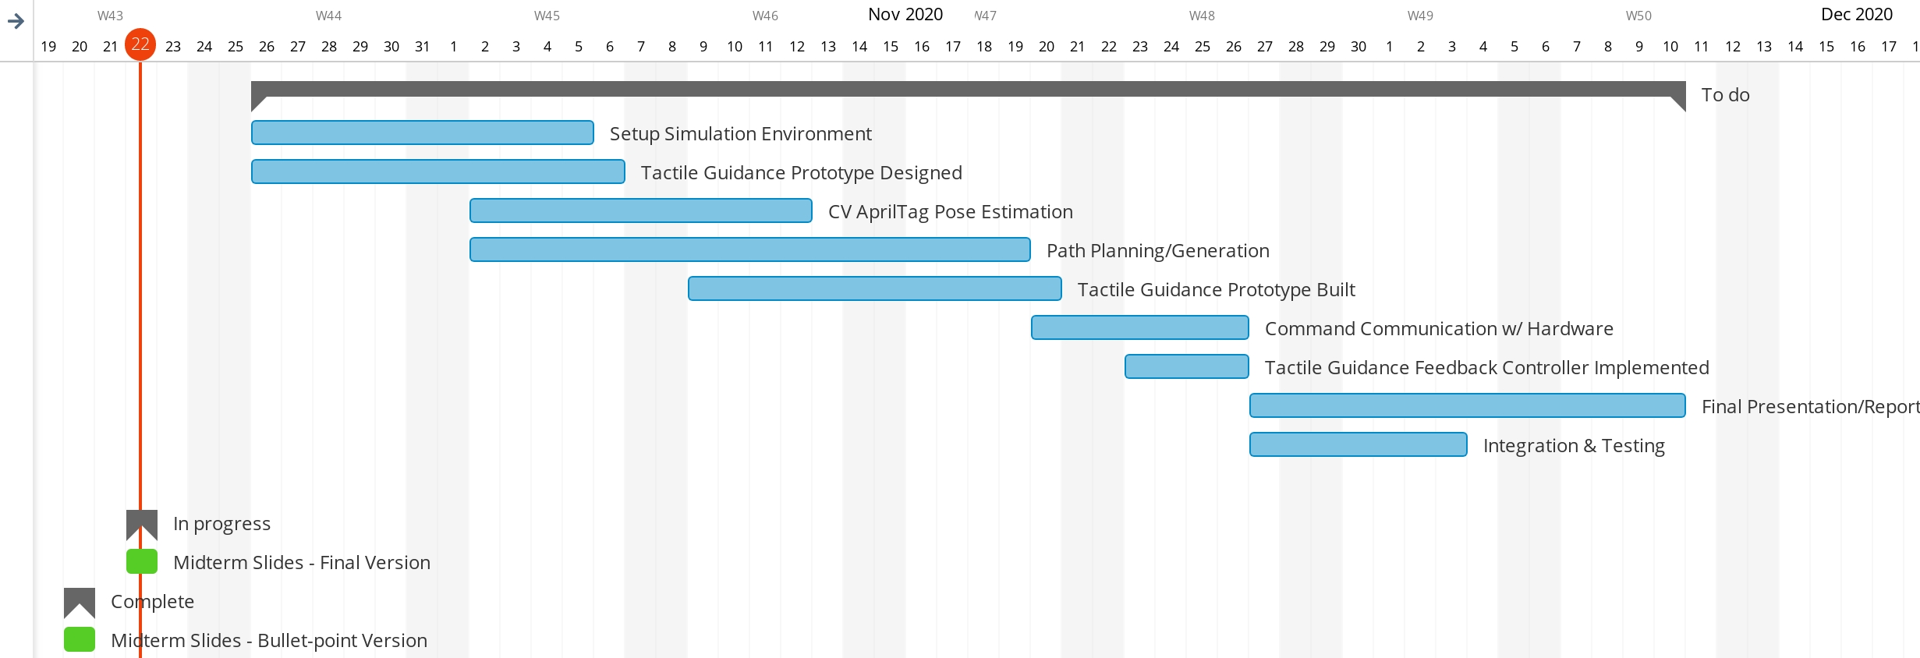
Gantt Chart

Slide 13

Future Applications - Universal Design
Guide all individuals safely to their destination
Identify locations to avoid
Use app to give updates about plan
Generate optimal paths through residential areas
Dynamic object identification and avoidance

Slide 14
Thank you!

